Slide 1


Shree swami atmanand saraswati institute of technology
Project on:
Aquaponics Farm Automation
(IDP)

Slide 2
Prepared by:
Smitesh Dhanani(150760111010)
Dhara Joshi(150760111026)
Krishna Lakhani(150760111036)
Deep Padmani(150760111045)
Kartik Sojitra(150760111053)
- Guided by : - Prof. Himanshu Rakholiya
- External Guided by : - Rikhil Shah(Rorbit Technology)

Slide 3
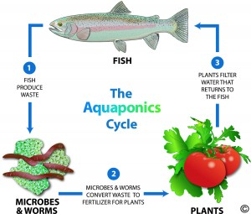
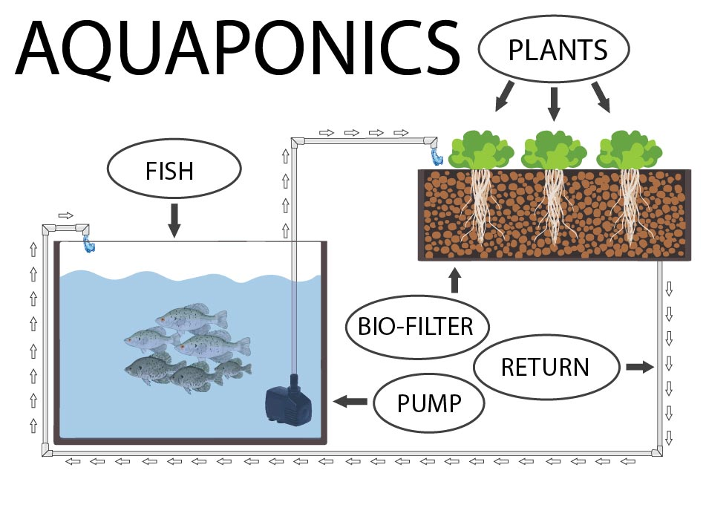
Introduction
The most simple definition of Aquaponics is the combination of aquaculture (raising fish) and hydroponics (the soil-less growing of plants) that grows fish and plants together in one integrated system.
The fish waste provides an organic food source for the plants, and the plants naturally filter the water for the fish.

Slide 4
Block Diagram
Power Supply +5V
Power Supply +3.3V
Ms Access Database
Master
Computer
(GUI)
ATmega328p
WIR-1186 (Transceiver Module)
USB to TTL
WIRELESS
COMMUNICATION
Water Supplier Motor
Power Supply +5V
Slave
Relay Module
ATmega328p
WIR-1186 (Transceiver Module)
Tank filler Motor
JSN-SR04T-2.0 (ultrasonic sensor)
16X2 LCD with I2C Module
Power Supply +3.3V

Slide 5
Flowchart: -
Start
YES
Com selection
NO
Comport Is Open
NO
Master side
YES
Case
A,B,C,D,E
Case A
TURE
Get tank level request to slave
Get
Data
NO
YES
FALSE
Graphical
Tank level Display in GUI
Case B
TURE
Field pump on request to slave
FALSE
Case C
TURE
Field pump off request to slave
FALSE
Case D
TURE
Tank pump on request to slave
FALSE
TURE
Case E
Tank pump off request to slave
FALSE

Slide 6
Flowchart: -
Start
YES
Tank level greater turn 20cm
NO
Tank filter off plant motor off
Request from Master
NO
Slave side
YES
Case
A,B,C,D,E
Case A
TRUE
Send the tank level data
FALSE
Case B
TRUE
Field pump on
FALSE
Case C
TRUE
Field pump off
FALSE
Case D
TRUE
Tank pump on
FALSE
Case E
TRUE
Tank pump off
FALSE

Slide 7
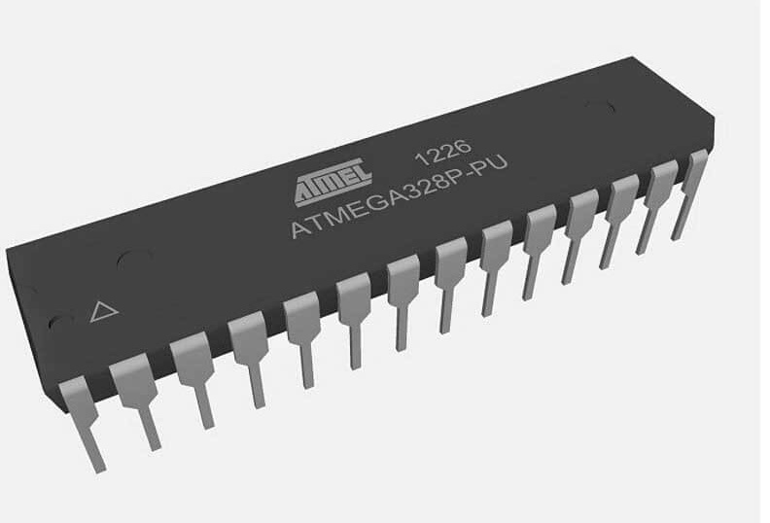
- :COMPONENT Description: -
ATmega328p: -
ATmega328/P is a low-power CMOS 8-bit and 28-pin microcontroller based on the AVR enhanced RISC architecture.
By executing powerful instructions in a single clock cycle, the ATmega328/P achieves throughputs close to 1MIPS per MHz. This empowers system designer to optimize the device for power consumption versus processing speed.

Slide 8
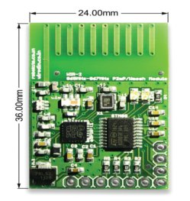
WIR-1186 (Transceiver Module): -
The WIR-1186 module is a low-power and half duplex, wireless communication solution that is ideal for Smart Grid, home automation, smart lighting, industrial sensor data acquisition and remote control applications.
VCC range: 3.2V – 3.6V supply voltage
Range: - 2KM
Frequency: - 865-869MHz Wireless serial link
Standard UART interface with hardware flow-control (Clear-to-Send CTS) for long data packet handling
From: - https://robokits.co.in/wireless-solutions/wireless-rf-serial-link-865-869mhz-2km-range

Slide 9
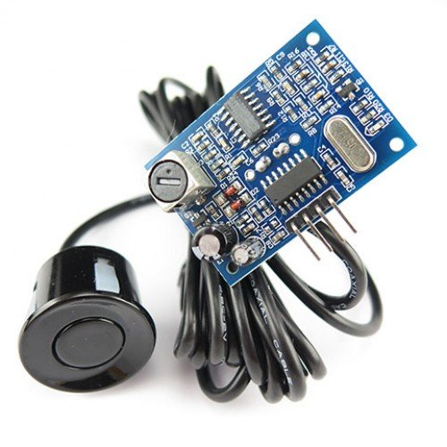
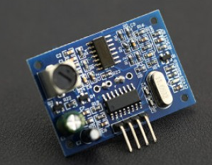
JSN-SR04T-2.0 (ultrasonic sensor): -
JSN-SR0T4-2.0 ultrasonic distance measurement module can provide 20cm-600cm non-contact distance sensing function, ranging accuracy up to 2mm; module includes the transceiver of an integrated ultrasonic sensor and control circuit.
Operating Voltage: DC 3.0-5.5V
Features:
small size, easy to use;
Water proof;
low voltage, low power consumption;
high precision measurement;
strong anti-interference;
integrated closed waterproof cable probe, suitable for wet, bad measurement occasions.

Slide 10
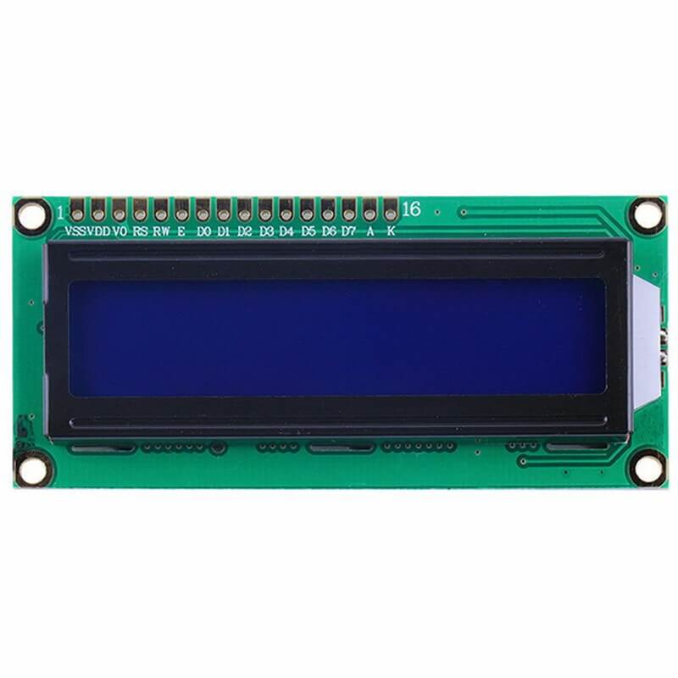
LCD (16x2): -
A 16x2 LCD means it can display 16 characters per line and there are 2 such lines. In this LCD each character is displayed in 5x7 pixel matrix. This LCD has two registers, namely, Command and Data.
LCD (Liquid Crystal Display) screen is an electronic display module and find a wide range of applications.
Input voltage: 4.7V to 5.3V
Current limit: 3mA (max.)

Slide 11
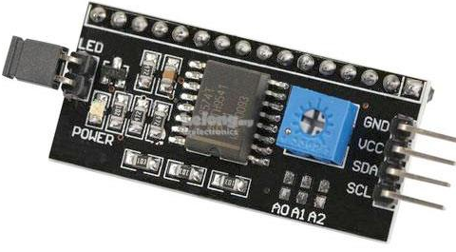
5. I2c module: -
Serial I2C LCD display adapter converts parallel based 16 x 2 character LCD display into a serial i2C LCD that can be controlled through just 2 wires.
Adapter uses PCF8574 chip that serves as I/O expander that communicates with Arduino or any other microcontroller by using I2C protocol.
SDA(serial data) and SCL(serial clock)
Features:
16 x 2 Character LCD display is controlled via just two wires.
Up to 8 LCD displays with adapters can be connected and controlled by the same two wire I2C bus .
Easy to control using Arduino board .
Adapter includes 16-PIN male header connector for soldering to LCD display.
Contrast is adjusted via on-board potentiometer.
Backlight may be turned on/off via jumper.
Standard 5V voltage supply.

Slide 12
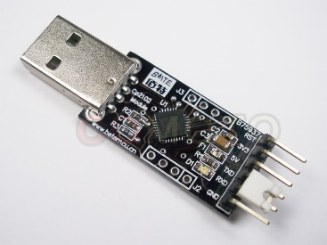
USB to TTL module: -
This module can be used with Laptop's which don't have standard serial port.
This module creates a virtual COM port using USB on your computer which can support various standard Baud Rates for serial communication.
Features:
Stable and reliable chipset CP2102.
USB specification 2.0 compliant with full-speed 12Mbps.
Standard USB type-A male and TTL 6pin connector.
6pins for 3.3V, RST, TXD, RXD, GND & 5V.
All handshaking and modem interface signals

Slide 13
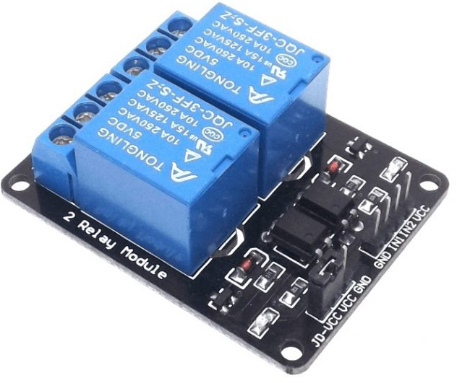
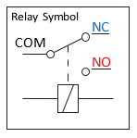
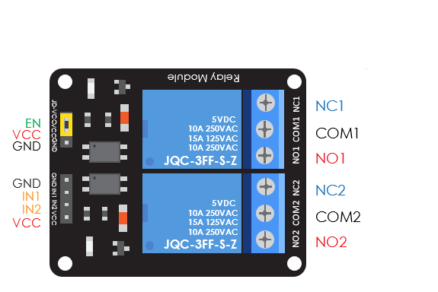
7. Relay Module(JQC-3FF-S-Z): -
The SRD-05VDC-SL-C relay has three high voltage terminals (NC, C, and NO) which connect to the device you want to control. The other side has three low voltage pins (Ground, Vcc, and Signal) which connect to the controller.
Features:
2 Channels of relay drive
Opto-isolator driven relay
5V Operated
Built-in indicator LEDs for each channel
Equipped with 250V 10A relay
SPDT Configuration for all relay channels

Slide 14
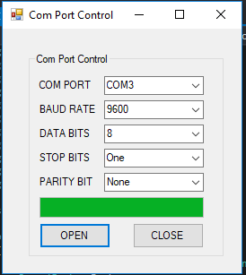
COM port selection: -

Slide 15
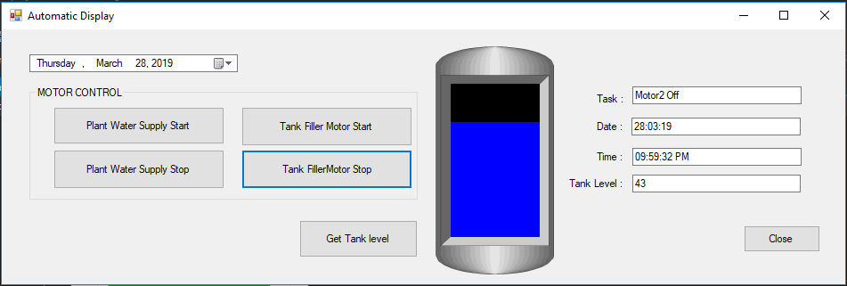
GUI: -

Slide 16
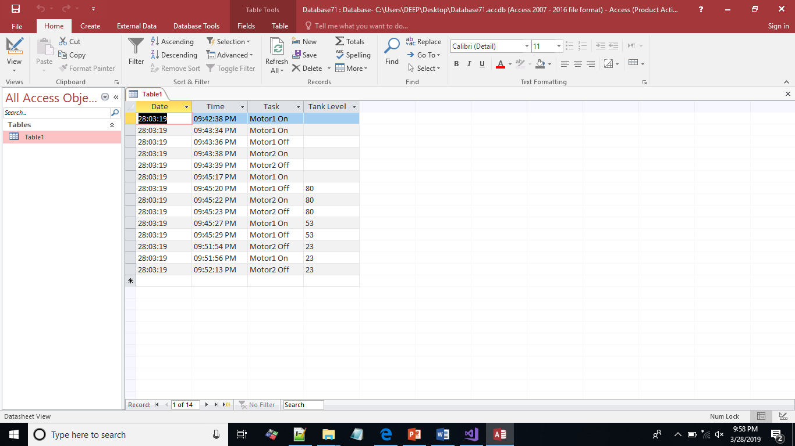
Data base: -

Slide 17
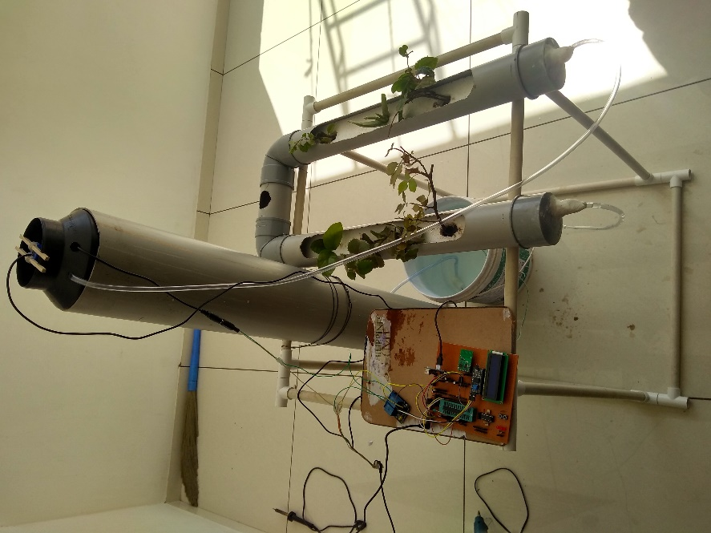
Hardware:

Slide 18
Software: -
GUI: visual studio using C#
Arduino IDE
REFERENCE: -
Roarbit Technology
Google
Datasheets

Slide 19
THANK YOU

Slide 20
Start
Com selection
YES
NO
Comport Is Open
NO
YES
Case
A,B,C,D,E
Case A
TURE
Get tank level request to slave
Get
Data
NO
YES
FALSE
Graphical
Tank level Display in GUI
Case B
TURE
Field pump on request to slave
FALSE
Case C
TURE
Field pump off request to slave
FALSE
Case D
TURE
Tank pump on request to slave
FALSE
Case E
TURE
Tank pump off request to slave
FALSE

